Slide 1

RESTful Web Service using Docker & Spring Boot
Pooja Songadkar

Slide 2
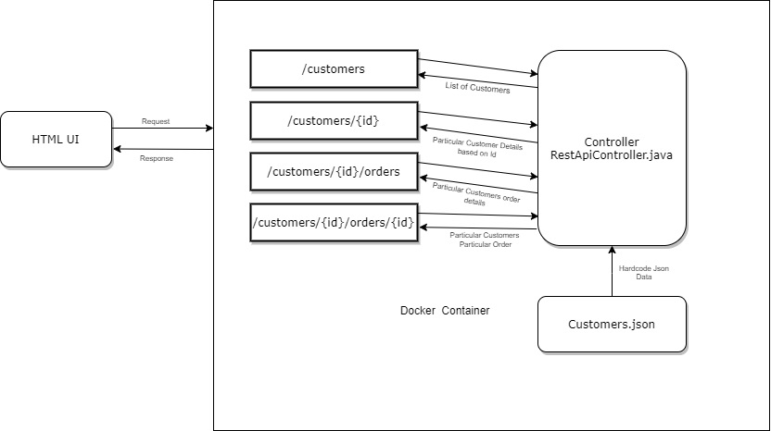
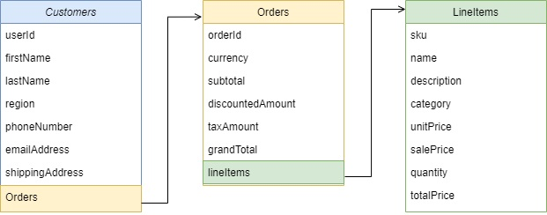
Json File Structure

